Slide 1

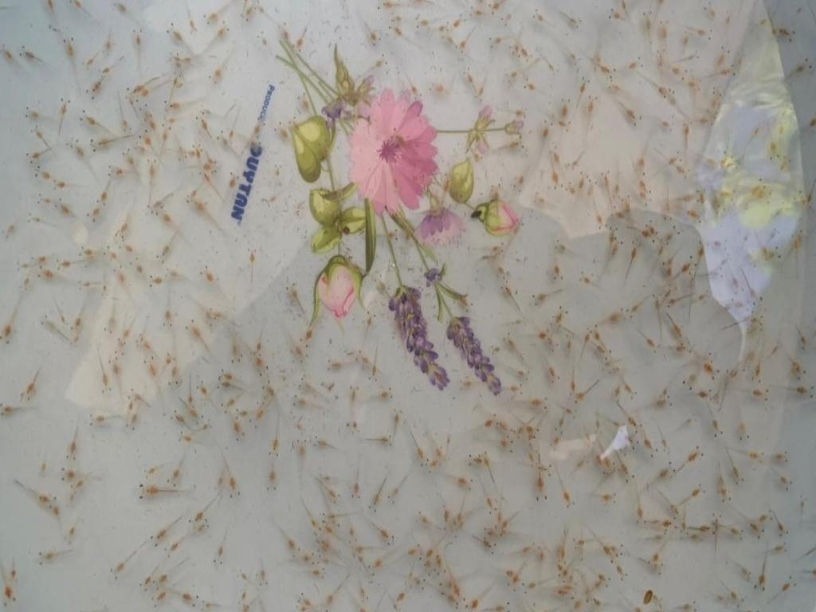
Chenf loss function
VGG Backbone
BiFPN
DeConv & Conv
P7: 512c (/64)
Conv
Up sample
P6: 512c (/32)
Down sample
P5: 512c (/16)
Concatenate Channels
P4: 256c (H/8, W/8)
3xHxW
P3: 128c (H/4, W/4)
P2: 64c (H/2, W/2)
P1: 32 Channels (H/1, W/1)
HxW

